Slide 1


Data Governance @ SneakerPark
Prepared by:
Submitted on:

Slide 2

How to use this Template
Theses slides are provided as a guide to ensure that you submit all the required components to successfully complete your project. For detailed instruction, please read the instruction in the classroom.
When presenting your project, please only think of this as a guide. We encouraged you to use creative freedom when making changes as long as the required information is present.
Remember to delete this and all of the other example slides before you submit your project.
Remember to add your name and the date to the cover slide
Remove this slide

Slide 3
What you are required to submit:
What we provide:
This Starter Slides Template
Sheets Template with 4 Tabs - Data Dictionary, Data Quality Issues, Standard Naming Convention, and Business Glossary
Workspace with an instance of Postgres and code that will create and populate the database you will be working with.
Grading rubric you can use to ensure you have submitted everything that is required.
Filled out Slides template.
Filled out Sheets template.
Remove this slide

Slide 4
Background
SneakerPark is an online shoe reseller that allows people to buy and sell used and new shoes. Buyers can bid for shoes or buy them outright, and sellers can set a price or sell to the highest bidder.
Each buyer and seller must have an active account in order to sell, bid, or purchase sneakers using SneakerPark’s website.
SneakerPark authenticates the shoes before shipping them to the buyer, so before listing an item, the seller must ship it to SneakerPark’s warehouse. Upon receipt, SneakerPark assigns an item number to each pair of sneakers and notifies the seller that they are now free to list their item. If the item is not listed within 45 days, SneakerPark returns it to the seller and sends an invoice to the seller for the shipping cost.
If the item is found to be inauthentic or in an unacceptable condition, it is also returned back to the seller in a similar fashion.
When the item sells, the buyer’s account is credited with the purchase price minus the SneakerPark service fee and shipping fees to deliver the item to the buyer.
Currently, SneakerPark only supports sales within the United States.

Slide 5
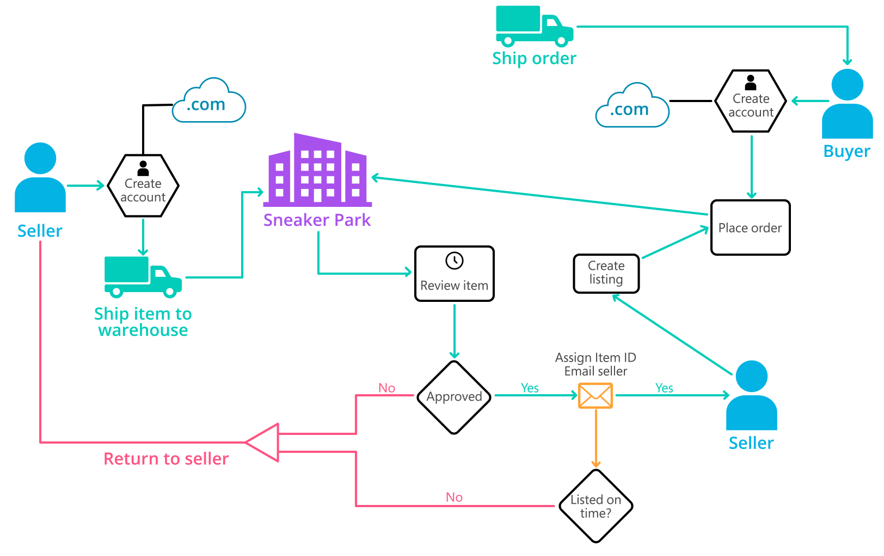
Background (cont’d)
Below you can see a diagram that will hopefully help you visualize some of SneakerPark's business processes. Keep in mind that it does not capture ALL processes and every nuance, but simply serves as another artifact to use in your project.

Slide 6
Step 1
Enterprise Data Catalog Part 1: Enterprise Data Model

Slide 7
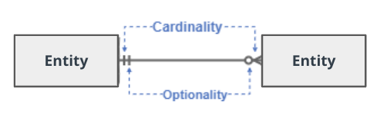
Create a conceptual data model that will provide SneakerPark with a holistic view of its data systems and help you grasp the organization's important entities and relationships, which will be instrumental as you move further in the project. You can use Lucidchart or any other diagramming tool of your choice, but please use the Crow’s Foot/IE Notation and please be sure to indicate both cardinality (the type of a relationship such as 1:N or N:N) and optionality (whether the relationship is optional or mandatory).

Slide 8
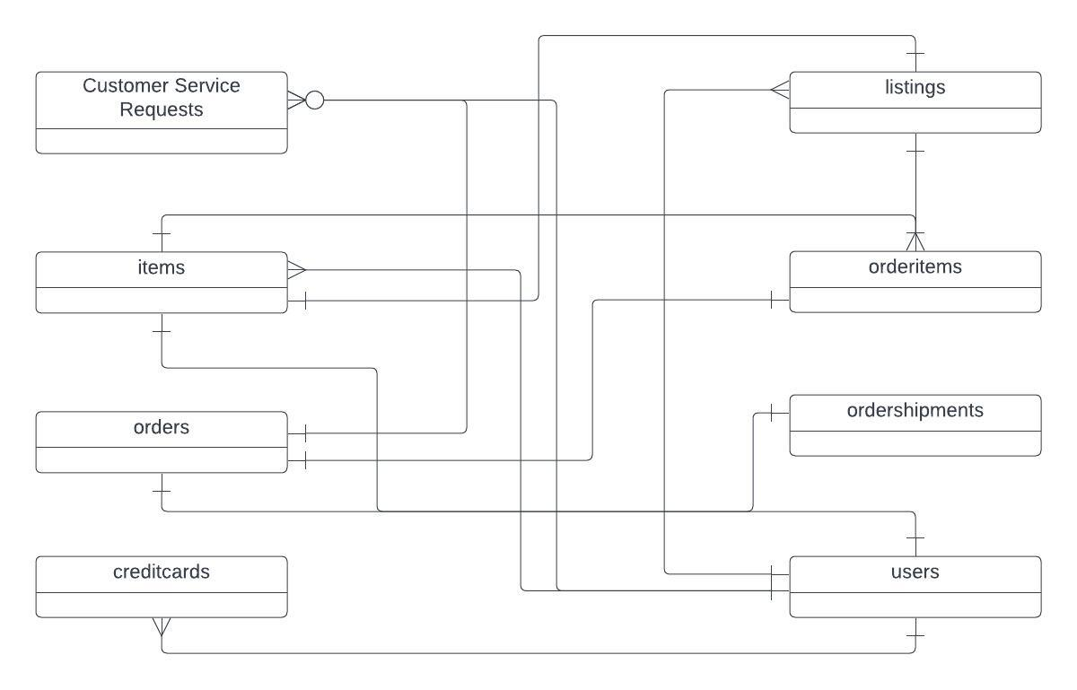
Replace the example below with your own solutions (obviously feel free to take more space):

Slide 9
Step 2
Enterprise Data Catalog Part 2: Metadata

Slide 10
Create the first version of the Metadata Catalog by documenting the metadata from all systems in the "Data Dictionary" and the “Enterprise Data Catalog” tabs of the provided Sheets template.
Please note that you are required to fill out all fields in both tabs.

Slide 11
Step 3
Data Quality
Part 1: Profiling and Cleansing

Slide 12
Profile the data to identify at least 3 data quality issues you see in the data. Also provide at least 1 data quality issue that you haven’t yet seen in the data, but can foresee occurring in the future. Based on the issues you’ve identified, come up with the data quality rule for each data quality issue, including for the one that you foresee.
Make sure you fill out all columns in the "Data Quality Issues" tab with your answers in the provided Sheets template.

Slide 13
Step 4
Data Quality
Part 2: Monitoring

Slide 14
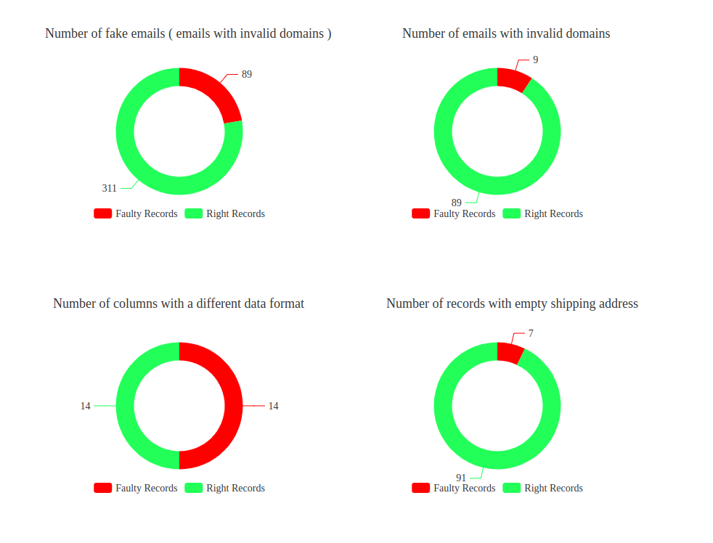
Using the metrics you've created in the last step, please create a mock-up of a data quality monitoring dashboard that will be used to monitor the data to ensure compliance with your data quality rules.
Please make sure to label your metrics clearly on your mock-up.
Replace the example dashboard below with your own. (obviously feel free to take more space).

Slide 15
Step 5
Master Data Management
Part 1: MDM Architecture

Slide 16
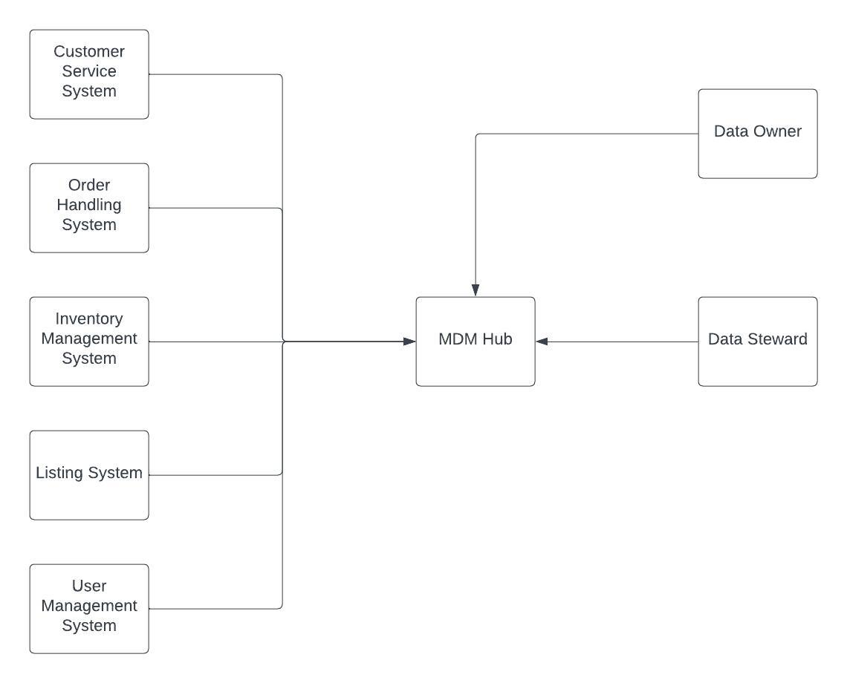
Based on what you’ve read about SneakerPark’s systems and business model, sketch out a proposed MDM implementation architecture, and write a detailed explanation of why you chose this specific approach.
Tip: Think about how your plan and its implementation might affect existing systems.
Replace example screenshot below with your own solutions (obviously feel free to take more space).
Next, please write at least a paragraph explaining your choice.

Slide 17
Explanation:
The ideal MDM architecture for SneakerPark at this stage can be the conslidation. This architecture has a medium level impact on the current state of affairs. Having systems only flowing data into a centralized MDM hub, and then applying standardization rules is an achievable target considering the current scale of the company. This architectures introduces a moderate level of complexity to current state architecture, introduces good level of data governance, and allows for better data accuracy and consistency.
While registry MDM architecture could be a good start too, it would not be as effective. This is due to the fact that registry MDM introduces the risk of metadata being in a false positive state. On the other extreme, a centralized MDM architecture is too big of an investment for a business like Sneaker Park, and takes substantial measures to materlize.

Slide 18
Step 6
Master Data Management
Part 2: Master Record

Slide 19
In this step, you will define a set of matching rules that will be used by the SneakerPark's MDM Hub to match item and customer entities between the company's different systems.
Please come up with 4 rules - 2 for Items and 2 for Customers and list them below.
Items rules:
Primary match: match on item ID
Secondary match: match on item ID, and seller ID
Customers rules:
Primary match: match on user id
Seconday match: match on firstname, lastname, and phone number

Slide 20
Step 7
Data Governance:
Roles and Responsibilities

Slide 21
Role 1 - Data Steward:
supporting the user community
collecting, collating, and evaluating issues and problems with data I think Jessica should handle this role as she is a subject matter on many areas and does understand the true definition of data in different domains.
Role 2 – Data Engineer:
Design, developed and curation of data pipelines
Ensures that data is available in the right format for various business cases I think Jake should handle this position as he is the guy who has a lot of skill in database administration and has been fixing data issues in the past.
Role 3 – Data Architect:
Ensure that right data is provided with the right amount of quality to the right stakeholders
Designs, and maintains large-scale data-intensive systems. I think I will be responsible for this as I’ve got a goo understanding of various area of data structure from modeling to meta data management, to master data management and data quality. Discussion: This new data governance requires several key roles in order to sustain and grow. One of the main roles is the data architect that foresees upcoming challenges and adjust components of the data governance architecture to it. The same stakeholder takes part in new initiatives and suggestions. Another key role is the data engineer that creates meta data management systems, data quality dashboards, and master data management pipelines. While data engineers and data architects are really important in development of the Sneaker park’s data governance initiative, data steward and data owners are as important for operating and maintaining these systems. Data stewards ensure that correct metadata is in place, data are matched in master data sets based on correct rules, and data quality threshold are defined correctly. On the other hand, data owners ensure that business metadata is defined correctly for their domain, the corresponding data has the required qualities and master data is in an acceptable structure.
The data steward's role essentially is to support the user community. This individual is responsible for collecting, collating, and evaluating issues and problems with data. Typically, data stewards are assigned either based on subject areas or within line-of-business responsibilities

Slide 22
Standout Suggestions

Slide 23
Create a Business Glossary for SneakerPark and define common terms such as Item, Buyer, etc. Think and discuss how SneakerPark can improve on the consistency of the terms that its systems currently use. (You can use the “Business Glossary” tab of the same Sheets template you’ve been using for the other parts of this project to get you started.)
Document SneakerPark’s current naming conventions. Can you think of any improvements? (You can use the “Standard Naming Conventions” tab of the same Sheets template you’ve been using for the other parts of this project to get you started.) Some examples of Naming Conventions include;
Do not use spaces or special characters.
Use only LOWERCASE.
All identifier fields should end in “_id”.
Avoid acronyms and abbreviations.
Write SQL scripts for the matching rules that you’ve created in Step 6.

